Slide 1
Smart Battery Charger
For you and for the world
Team members:
Anna Geraci
Carlo Simone
Fabio Gianino
Michele Petrocelli

Slide 2
General information about Smart Battery Charger application
Objective:
Main characteristics:
Stakeholders:
IMMAGINE

Slide 3
Communication paradigms used
REST:
How it works
MQTT How it works

Slide 4
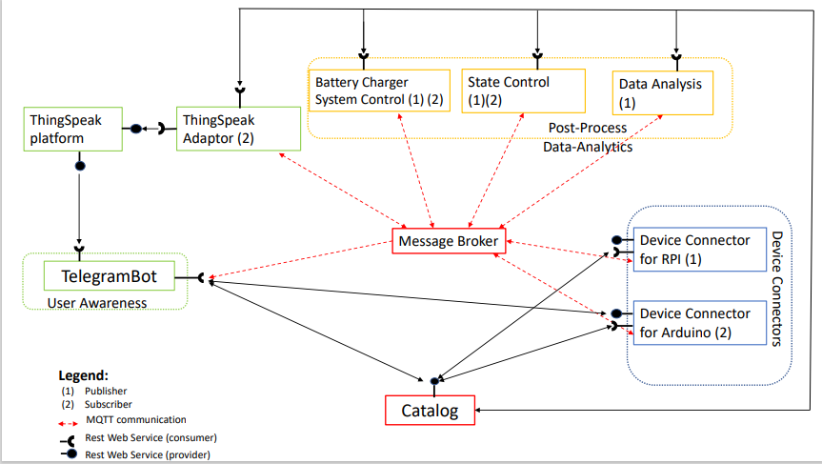
Use Case Diagram - proposal

Slide 5
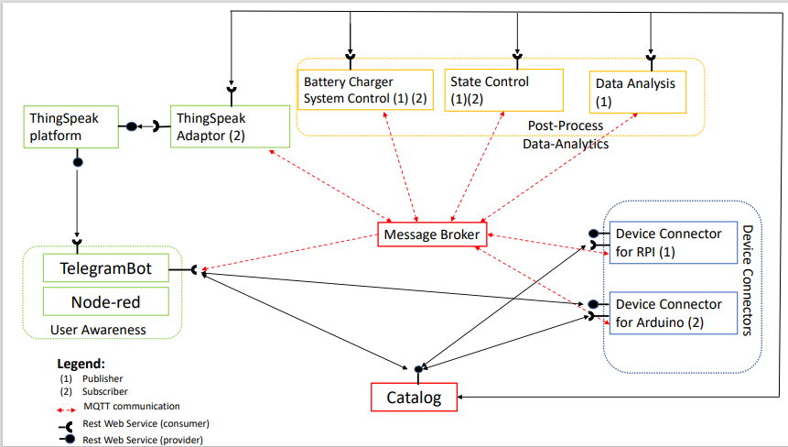
Use Case Diagram - update

Slide 6
Catalog

Slide 7
Device Connectors

Slide 8
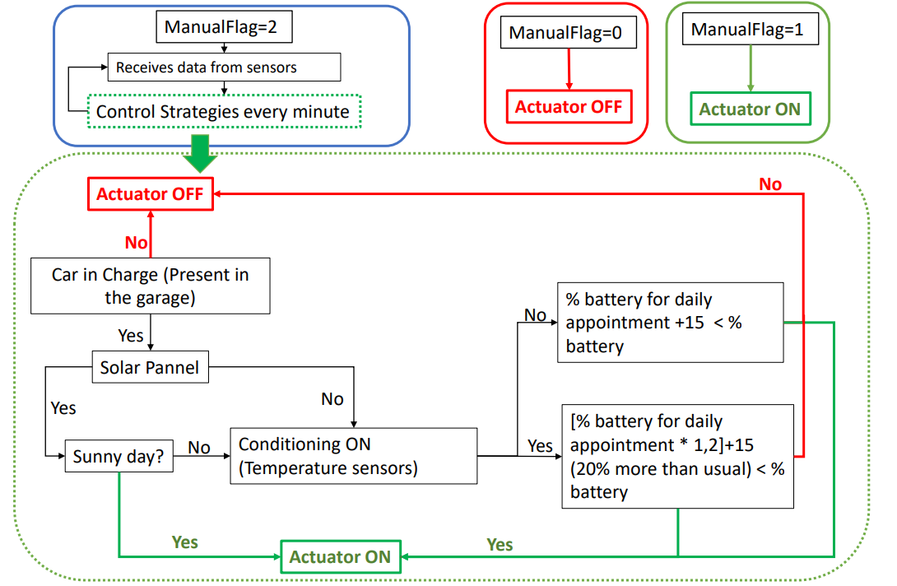
Battery Charger System Control
Communication with:
Sensors: Retrieves data from sensors and process them.
Actuator: Sends command to the actuator (On/Off).
User: Retrieves data about what the user want through User Awareness interface (Node-red and Telegram - ManualFlag).
Catalog: Retrieves data of the user and general data of the application; and publish the value of the actuator computed.
Control Strategy Agenda: Retrieves the value of the percentage of battery necessary in this day according to the Agenda of the user.
Main role:
Retrieve data and choose if the car must be in charge or not according to the logic reported on the right.

Slide 9
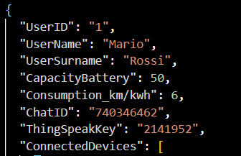
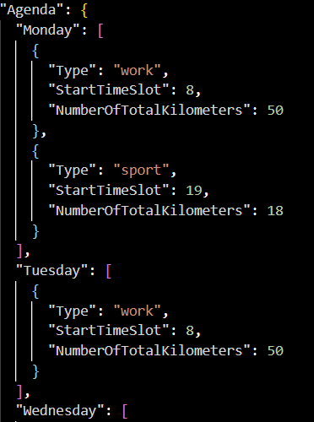


Agenda Control Strategy Compute the percentage of battery necessary to the specific user each day, according to the Agenda information.
Catalog Format in User section
Communication with:
Catalog: to retrieve information about user’s battery characteristics and user’s Agenda.
StateControl: To communicate AlertSMS, in case it may be necessary.
Actuator Control Strategy: to give information about the percentage of battery needed by the user in this specific day.
Main role:
Compute the percentage of battery necessary for the users during this day, according to the battery characteristics and the personal commitments.
Battery Capacity (KWh)
Battery Consumption (km/KWh)
Autonomy of the electric vehicle with 100 % of battery (km)
Yes
Km necessary to cover all the daily appointment > max autonomy in km of the user’s battery?
No
Send an alert to communicate to the USER that the number of total km is too high, so could be necessary to recharge the car between 2 commitments.
Send to the actuator control strategy the value of the battery’s percentage necessary for the following day.
EnergyNecessary $=\frac{NumberKmPerDay}{Battery Consumption}$[KWh]
Battery $=\frac{EnergyNecessary∗100}{Battery Capacity}$ [%]

Slide 10
State Control

Slide 11
Data Analisys & ThingSpeak

Slide 12
Node-red

Slide 13
Telegram Bot

